Slide 1
IoT Workshop
Ofek Dadush, Software Engineer @ ASC for IoT
© Microsoft Corporation

Slide 2
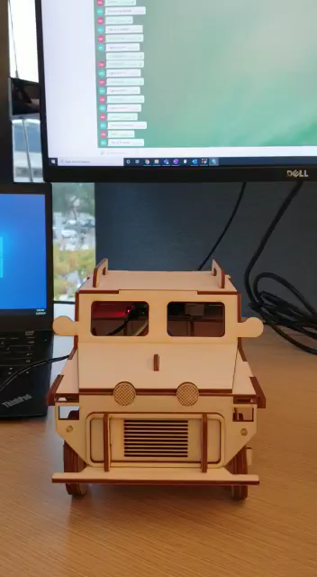

Slide 3
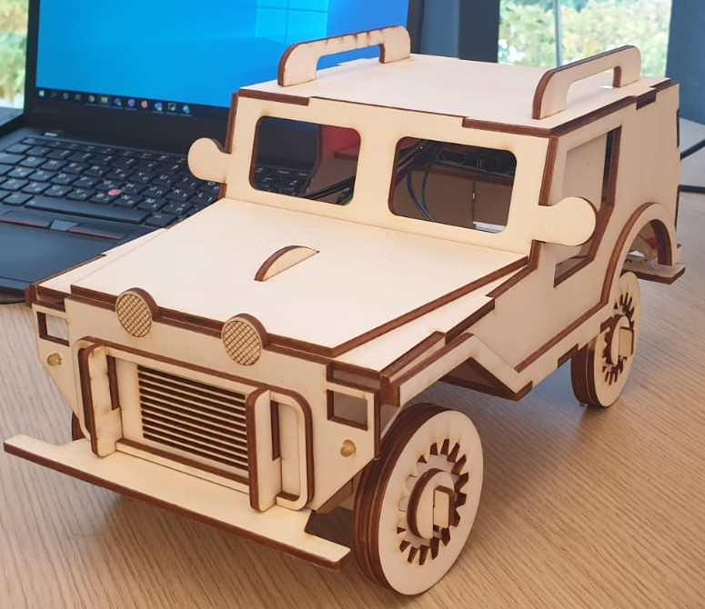
Car Overview
Lights:
Turn on/off
Check state
Lock:
Lock/unlock
Check state
Location:
Get car location

Slide 4

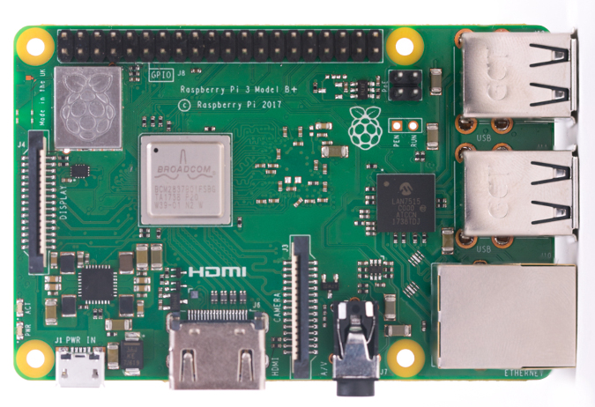
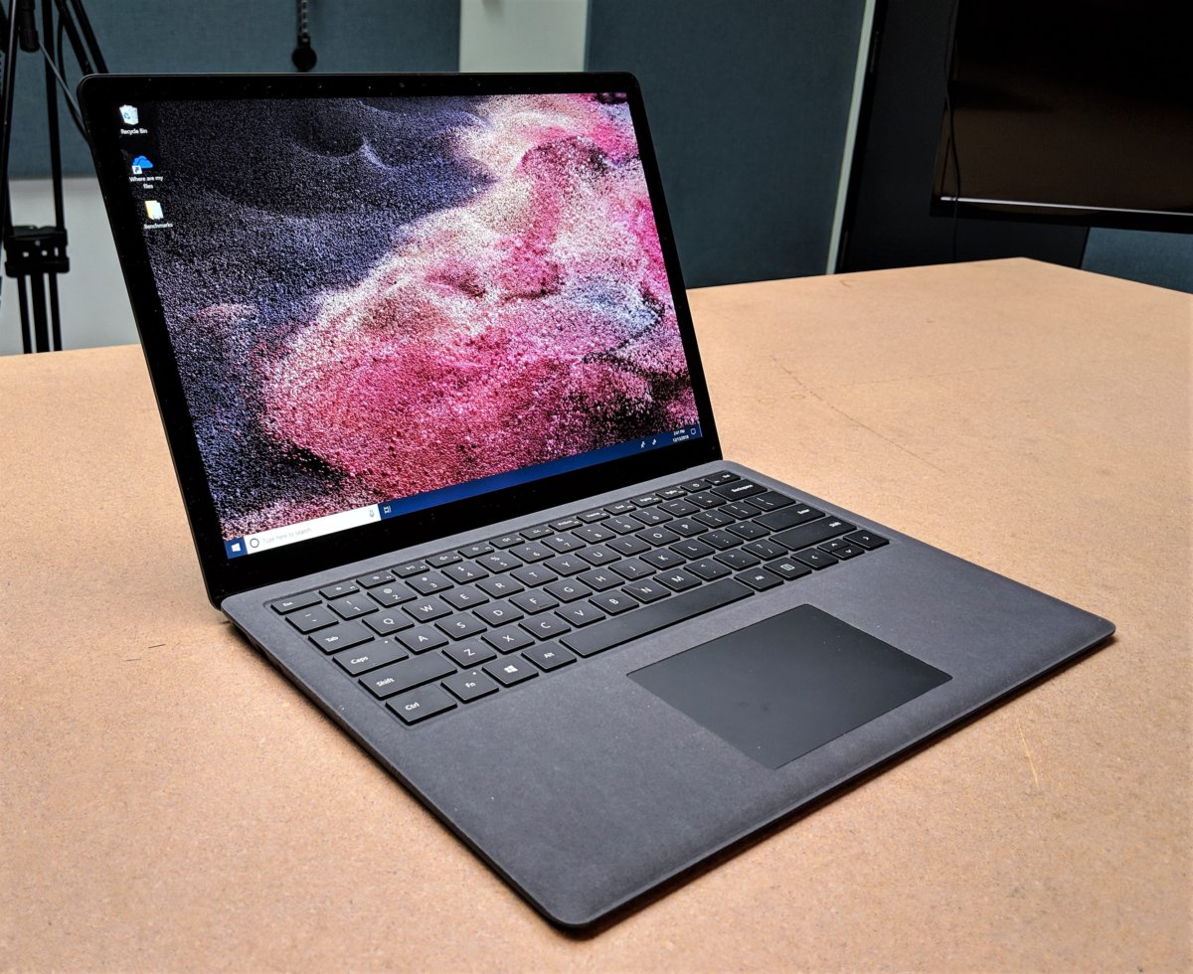
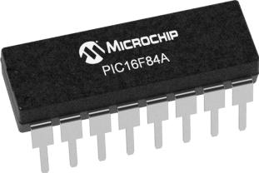
From microcontrollers to fancy computers
Microcontroller
Single board computer
Fancy Computer
Microcontroller
Expansion board/ breakout board

Slide 5
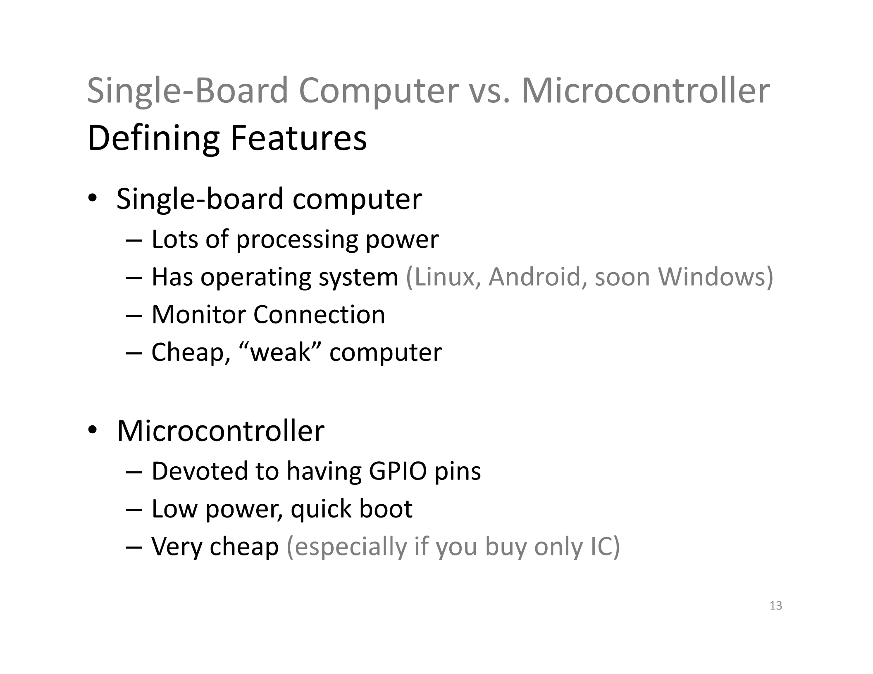

Slide 6
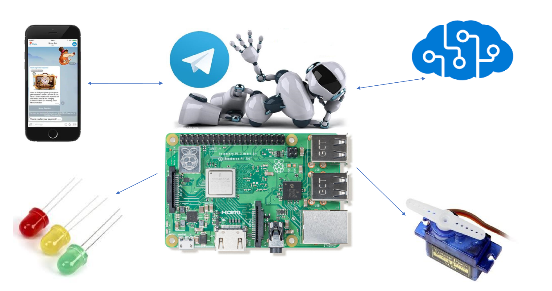

Slide 7
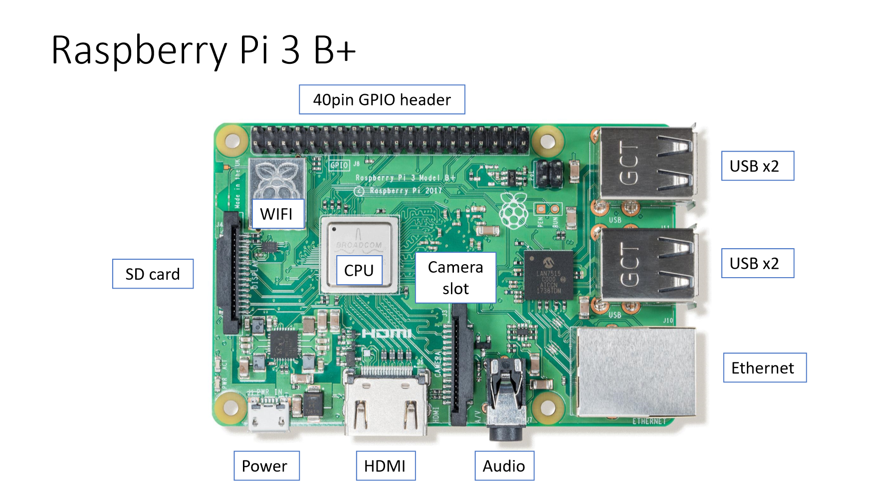

Slide 8
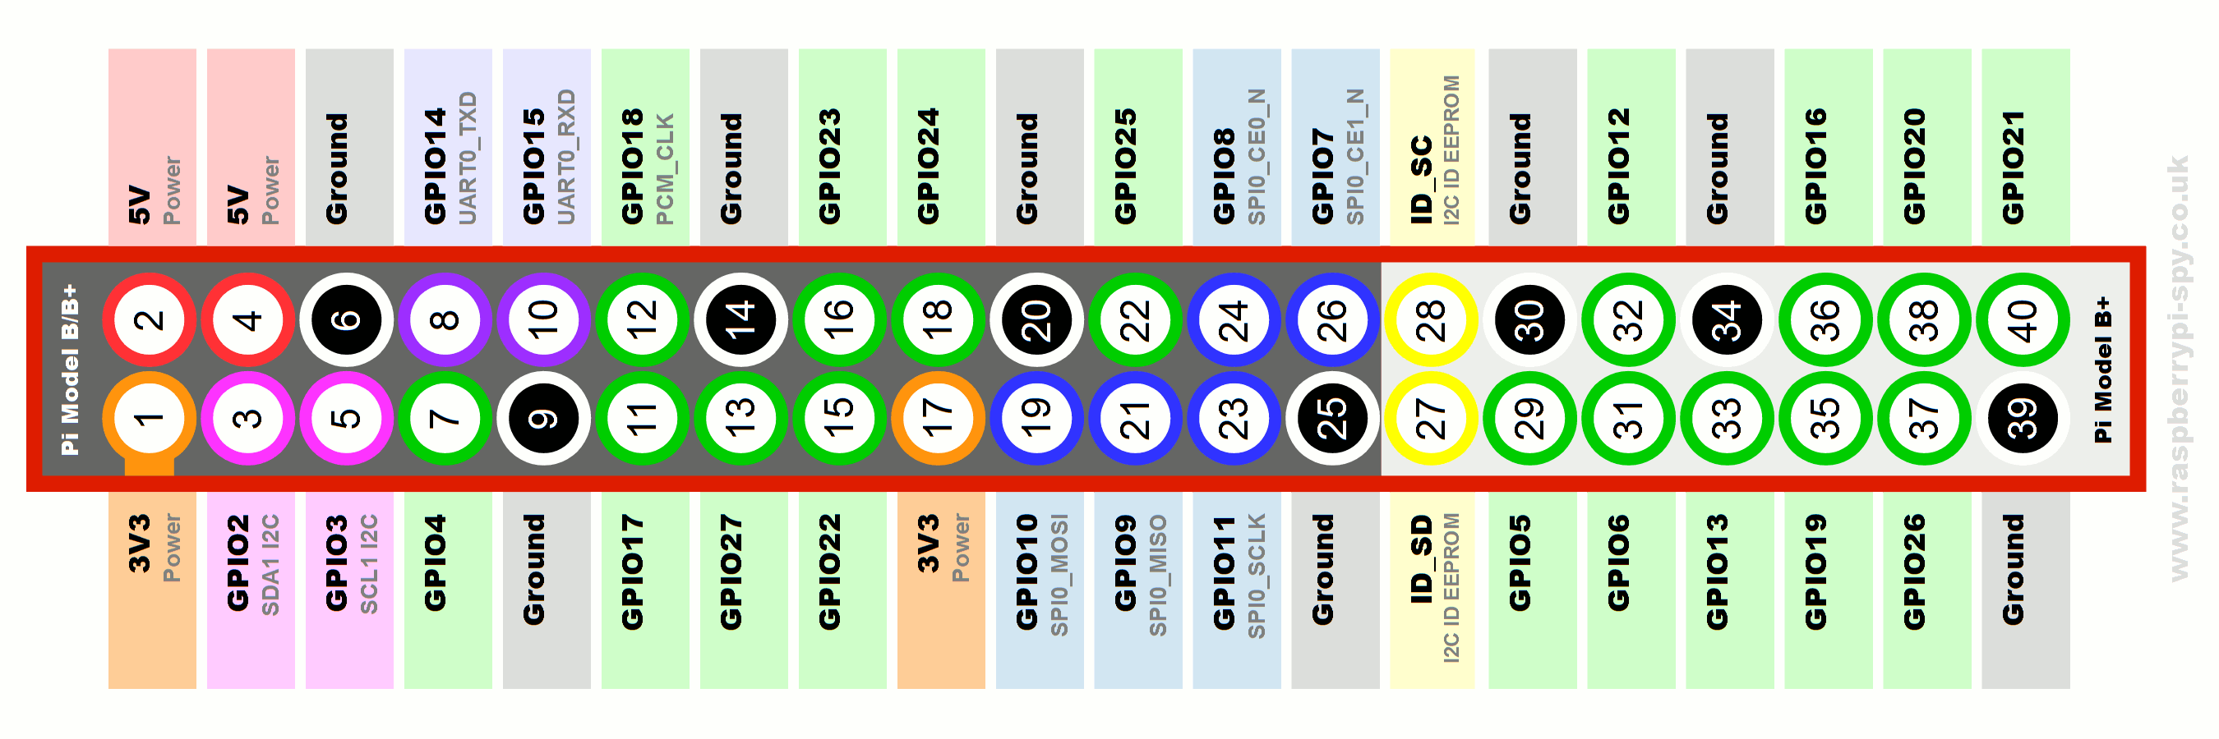

Slide 9
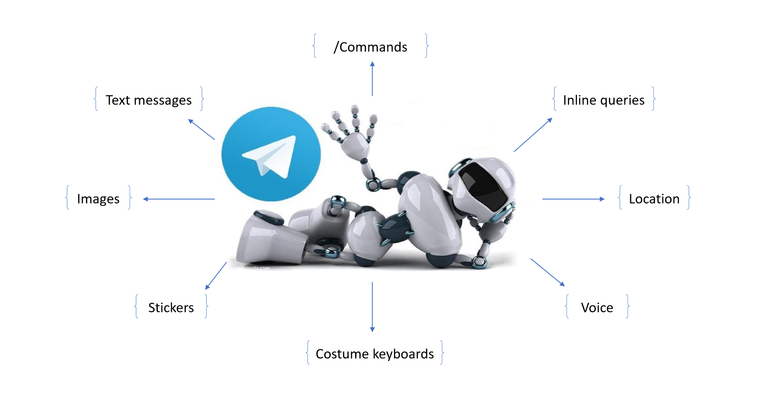

Slide 10
links
WinSCP –
https://winscp.net/eng/download.php
Putty - https://www.chiark.greenend.org.uk/~sgtatham/putty/latest.html
Git Hub repository – https://github.com/ofdadu/IoT-Workshop.git

